Slide 1

JDA ability to execute

Slide 2







SUPPLY CHAIN
JDA Portfolio™ Footprint
Vendors
Portals
150
pairs
Strategic Merchandise Management
495
610
Manufacturers
Planning
&
Forecasting
Replenishment
&
Allocation
Revenue
Management
3,600
Warehouse
Advanced Optimization
Top 3 out of 5
DEMAND CHAIN
Collaboration
Customer Relationship Management
Business Intelligence
Distrib.Center
Transaction Management
Warehouse
Management
Merchandise
Management
Store Systems
Store
Integration Framework
Consumer

Slide 3




























Sample clients is related industry

Slide 4
SUPPLY CHAIN
JDA recommendation for Casper
Vendors
Store Portals
Strategic Merchandise Management
Manufacturers
Arthur and Intactix
Planning
&
E3 Forecasting
E3 Replenishment
&
E3 Allocation
Revenue
Management
Warehouse
Seasonal Profiling & Channel Clustering
& Event Lift
DEMAND CHAIN
E3 Collaboration
Customer Relationship Management
Performance Analysis by IDEAS
Distrib.Center
Transaction Management
McKesson
& third party
Portfolio
Merchandise
Management
Auto Star
Nexxsys
Store
Integration Framework
Consumer

Slide 5
SUPPLY CHAIN
Business Release 1 (Casper)
Vendors
Store Portals
Strategic Merchandise Management
Manufacturers
Arthur and Intactix
Planning
&
E3 Forecasting
E3 Replenishment
&
E3 Allocation
Revenue
Management
Warehouse
Seasonal Profiling & Channel Clustering
& Event Lift
DEMAND CHAIN
E3 Collaboration
Customer Relationship Management
Performance Analysis by IDEAS
Distrib.Center
Transaction Management
McKesson
& third party
Portfolio
Merchandise
Management
Auto Star
Nexxsys
Store
Integration Framework
Consumer

Slide 6
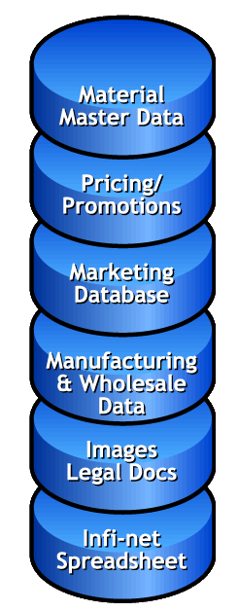



ECCnet product synchronization
Integration
&
Aggregation
Enterprise
Data
Repository
Management
Product Data
Synchronization
Vendor
EAN/UCC
Data
TP
Specific
Data
Retailer’s
Data
Aggregate product information from all internal users and departments
Data Repository as the “one version of the truth”

Slide 7
Minimum Business Release 1 (Casper)
Financial Reconciliation
Invoice Matching
v
Sales Audit
Retail Stock Ledger
Merchandise Transactions
Sales Audit
Cost / Deal Mgmt
Vendor Product Costs
Off Invoice & Rebates
Landed Cost Factors
Retail Price Mgmt
Regular & Promos
Competitive
Suggested Pricing
PO Management
Store Allocations
Open to Buy Review
Contract Orders
Transfer Mgmt
Stock Balancing
Warehouse Allocations
Inter-Location Transfers
Inventory Control
Perpetual On Hands
Physical Inventory
Return to Vendor
Auto Replenishment
Multiple Methods
Suggested Orders
Foundation Data / Registry
Products Vendors Organization Calendar
Data Manager / SDI
Vendor Submissions

Slide 8









Sample PMM clients
Intergro
Inwear

Slide 9
Clustering Stores by performance
Sales mix relationships
Stores 101, 400, 324
Stores 223, 567, 327
Store Volume bands
Store Capacities
Stores 376, 150, 241
Stores 111, 259, 112
Store Personalities
Seasonality Curves
Geography
Demographics

Slide 10
Workflow for the “Offering”
Market
Develop Products
Develop Clusters
Match
Assortments
to Clusters
Step 1
Recommended
Products
Clustering
Refine Assortments per Cluster
Step 2
Match Assortment To Space
Assortment
Narrowing
Store
Product
Assortment
Develop Planograms
Step 3
Assign Planograms To Stores
Matching to
Space
Store
Offering
(in stock)
Validate Assortments
Step 4
Distribute
Planograms
Validation
Replenish
Step 5
Execution
Execute
Customer
Selection
Notes:
Selection to Shelf involves the following workflow processes.
Develop Products/Plan Clusters/Develop Assortments in CCI. First create products, and clusters, then design master product assortments into those clusters according to the demands of the category. This also involves the use of pro/sortment EIA to refine the assortments completely.
Manage Space. Managing space is the process of taking the assortments and designing planograms and floorplans for them. Using pro/sortment you create/update planograms from assortment recommendations made in that application. Create Floor to Planogram Assignment. This task assigns categories to floorplans, manages and creates shell planograms for un-planogrammed areas, manages the development of existing planograms from pro/floor. Develop/Approve planograms/floor plans. This task involves many subtasks within the organization but results in completed, optimized, approved planograms and floor plans. Validate Assortments. This task coordinates pro/floor with Arthur Assortment and Allocation to validate unit requirements by department.
Manage in-store. This procedure involves getting the designed information to the stores and making the in-store reality match the planograms and floor plans. Major Task. Distribute Planograms – This task involves printing, mailing, internet, etc. any in a series of distribution methods used to make sure planograms are delivered to the right stores at the right times. IN-store execution. The last 5 feet of space management is the process of stocking shelves and arranging fixtures properly according to plan.
Selection to Shelf involves the following workflow processes (in pink). Within each process major tasks (in blue) establish a best practices process for moving the entire process forward.

Slide 11
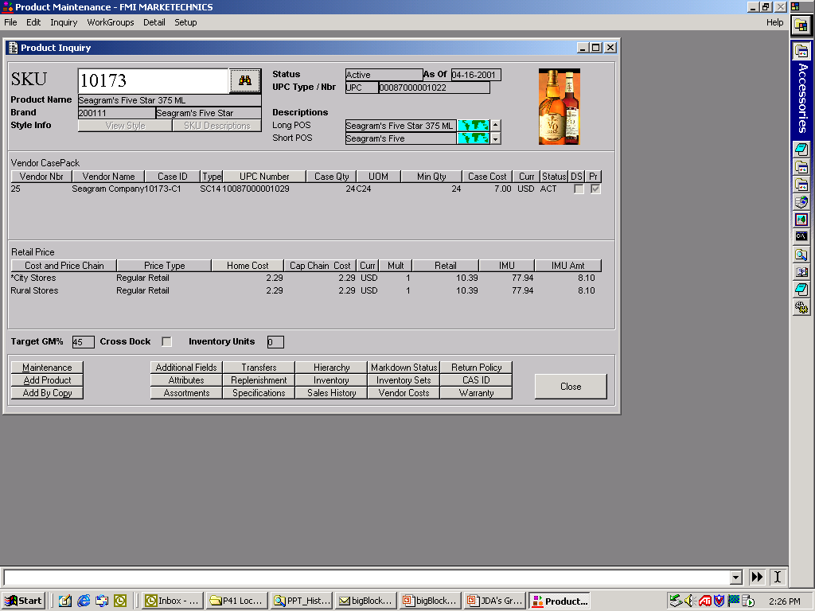
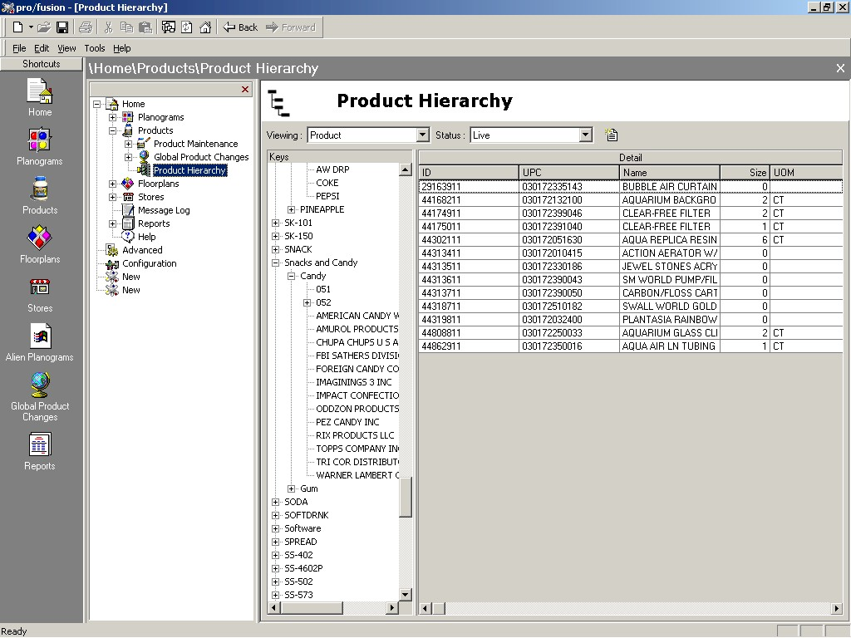
Develop Products
Develop Products
PMM / ECCnet
Develop Clusters
Match
Assortments
to Clusters
Refine Assortments per Cluster
Match Assortment To Space
Develop Planograms
Assign Planograms To Stores
Pro/fusion
Validate Assortments
Distribute
Planograms
Replenish
Execute
Notes:
Product development, done in a warehouse environment, makes product data available to various entities within the organization including space management. For our usage, it serves to provide the market of products we want in our assortment. It also serves to help match the POS data from stores to the products themselves for the use of the clustering tool.

Slide 12
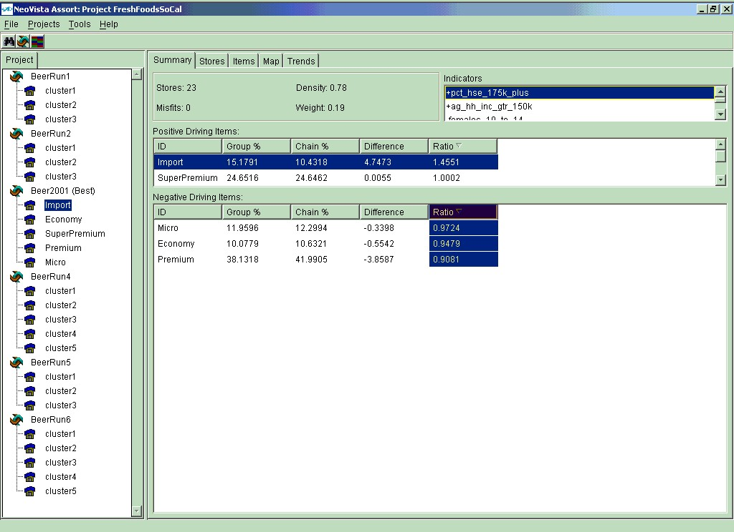
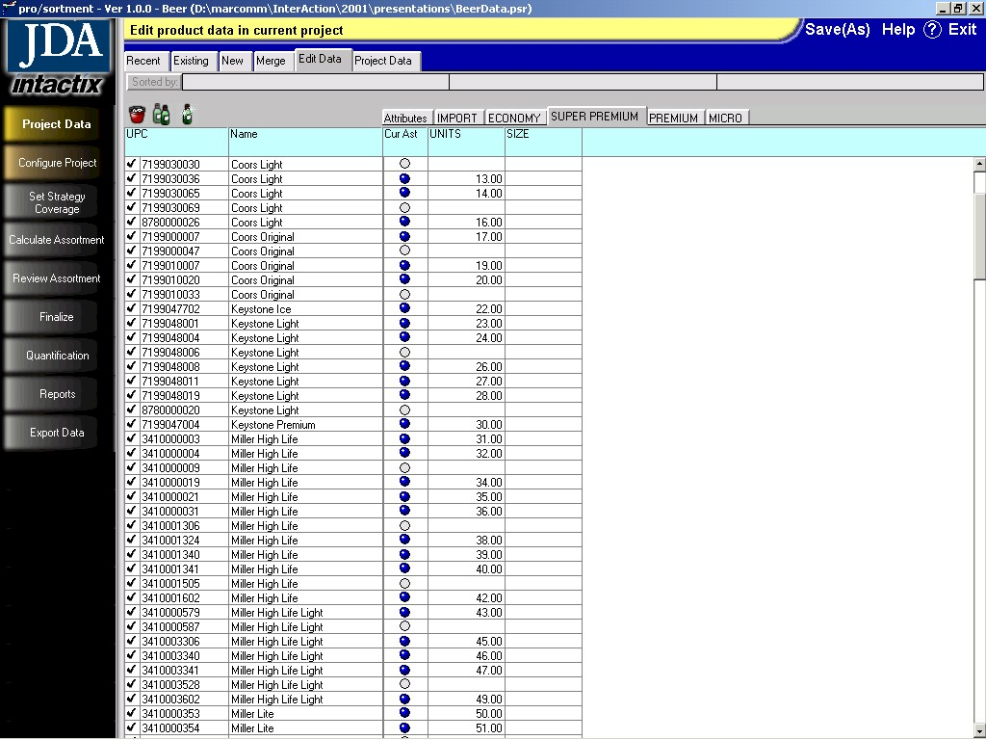
Clustering
Develop Products
Develop Clusters
Match
Assortments
to Clusters
Channel
Clustering
Intellect
Refine Assortments per Cluster
Match Assortment To Space
Develop Planograms
Assign Planograms To Stores
Validate Assortments
Assortment
pro/sortment
Distribute
Planograms
Replenish
Execute
Notes:
Planning clusters using Intellect helps group stores according to common parameters, thus making it easy to make category placement decisions for every cluster and store. Clustering can be done at the SKU level thus making the data available to space plannign applications.
Pro/sortment is a SKU-based EIA tool for refining assortments. With data driven into it from Intellect and combined with market data (POS, IRI, Nielsen, Panel, Household, etc.) assortments can be refined by cluster so that a recommended assortment list can be created.
That data is made available via ODBC to pro/space, the planogramming tool for proper creation/update of clustered planograms.

Slide 13
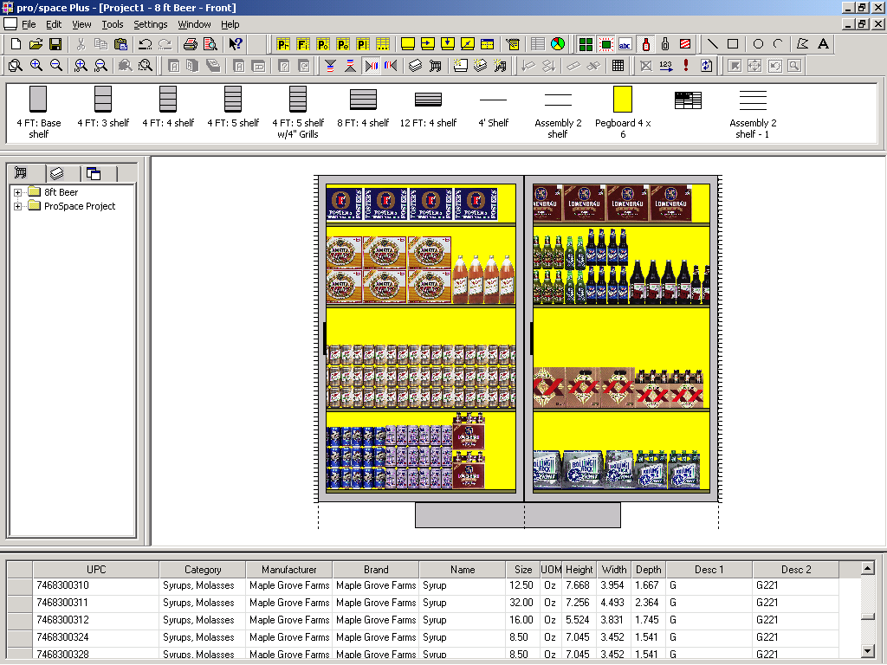
Assortment to Space constraints
Develop Products
Develop Clusters
Match
Assortments
to Clusters
Refine Assortments per Cluster
Assortment
pro/sortment
Match Assortment To Space
Develop Planograms
Assign Planograms To Stores
Validate Assortments
Planogram
Pro/space
Distribute
Planograms
Replenish
Execute
Notes:
Here, the refined assortments from pro/sortment are used to create/update clustered planograms. This is easily done in either of several methods. The preferred method is to save pro/sortment decisions directly to pro/fusion, but you can use the export function in pro/sortment to connect to any space planning system.
Another method is to provide CSV output and link that to an ODBC DSN and connect to pro/space, but the user will have to manually update planograms.

Slide 14
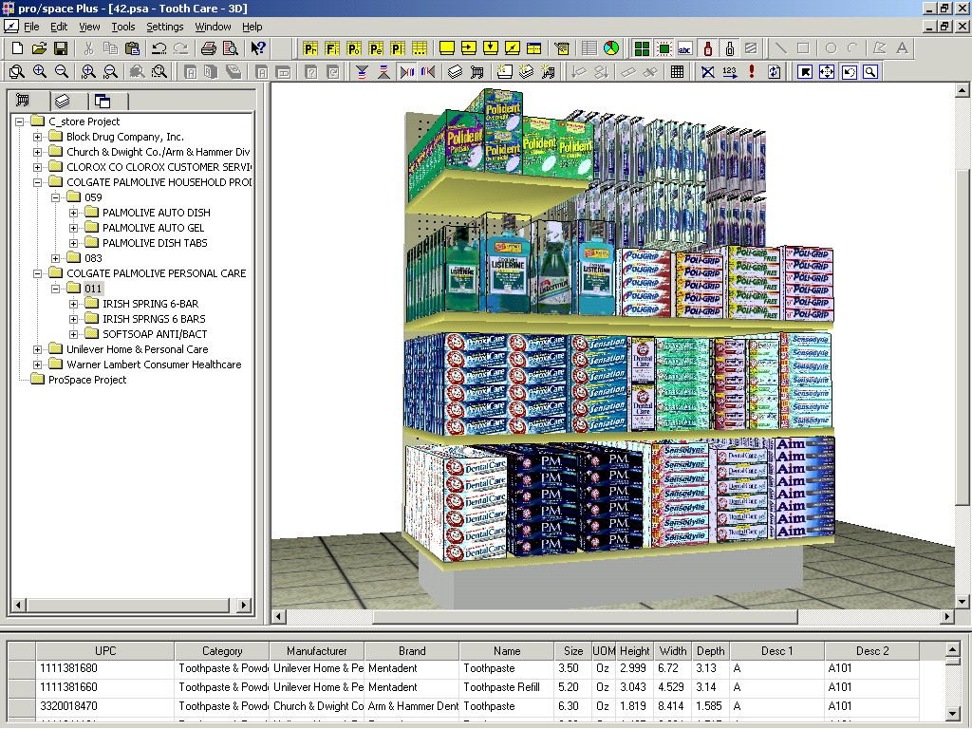
Process flow Final Visualization

Slide 15
Extended Business Release 1 (Casper)
Financial Reconciliation
Invoice Matching
v
Sales Audit
Retail Stock Ledger
Merchandise Transactions
Sales Audit
Cost / Deal Mgmt
Vendor Product Costs
Off Invoice & Rebates
Landed Cost Factors
Retail Price Mgmt
Regular & Promos
Competitive
Suggested Pricing
PO Management
Store Allocations
Open to Buy Review
Contract Orders
Transfer Mgmt
Stock Balancing
Warehouse Allocations
Inter-Location Transfers
Inventory Control
Perpetual On Hands
Physical Inventory
Return to Vendor
Auto Replenishment
Multiple Methods
Suggested Orders
Foundation Data / Registry
Products Vendors Organization Calendar
Data Manager / SDI
Vendor Submissions

Slide 16
SUPPLY CHAIN
Business Release 2 (Casper)
Vendors
Store Portals
Strategic Merchandise Management
Manufacturers
Arthur and Intactix
Planning
&
E3 Forecasting
E3 Replenishment
&
E3 Allocation
Revenue
Management
Warehouse
Seasonal Profiling & Channel Clustering
& Event Lift
DEMAND CHAIN
E3 Collaboration
Customer Relationship Management
Performance Analysis by IDEAS
Distrib.Center
Transaction Management
McKesson
& third party
Portfolio
Merchandise
Management
Auto Star
Nexxsys
Store
Integration Framework
Consumer

Slide 17






















































Success across many industries

Slide 18




Case Studies
$400M Cash (1st 12 months)
247% Stock Growth
2^{1/2}% Loss Sale Recovery
Increased Customer Revenue by 12%
Improved Forecast accuracy by 7%
Manco:
28% Reduction in Distribution
18% Freight Reduction costs
Generated $25M in bottom
line profits
Over $110 Million reduction in first 9 months and still growing
15% sales increase per store
In-stock from 76% to 94.5 %
Margins from 9% to 19%

Slide 19
Katz to MeKesson Replenishment road map
McKesson
Suppliers
McKesson
Warehouses
Demand Pull
Demand Pull
Katz
Stores
Shipment
/ Store RQ
P
O
R
T
A
L
(E3 Marketplace) Collaborative
Replenishment
AWR Forecasting
CPFR
VMI
Replenishment
Optimization
(eDA) Order Projections / Commitments

Slide 20
Katz to MeKesson Replenishment road map
McKesson
Suppliers
McKesson
Warehouses
Demand Pull
Demand Pull
Katz
Stores
POS
P
O
R
T
A
L
(E3 Marketplace) Collaborative
Replenishment
AWR Forecasting
CPFR
ASR Forecasting
Optimization
VMI
Replenishment
Optimization
Replenishment
Optimization
(eDA) Order Projections / Commitments
Allocation

Slide 21
Better Allocation
Constrained supply
Promotion orders
Season opening orders

Slide 22
Seasonal Profiling
Aggregation of historical sales over time, across stores, and / or across item hierarchy
  Problem – manual process driven by intuition and experience
Seasonality determined by store / item level performance
  Solution – automated process using actual demand at store level within a category / department
4
3.5
Match
Unique
3
2.5
Shifted
2
1.5
1
0.5
0
1
2
3
4
5
6
7
8
9
10
11
12
13
14
15
16
17
18
19
20
21
22
23
24
25
26
27
28
29
30
31
32
33
34
35
36
37
38
39
40
41
42
43
44
45
46
47
48
49
50
51
52

Slide 23
Case Study
Sample Business Value:
  Wal-Mart:
  “The tailored assortments resulted in a 32.5% sales increase, a 46% inventory reduction and an 11% improvement in category turn.”
SUPERMARKET NEWS 4 MAY 1999
  Average 1-4% sales increase AND 2-7% inventory decrease

Slide 24
SUPPLY CHAIN
Business Release 3 (Casper)
Vendors
Store Portals
Strategic Merchandise Management
Manufacturers
Arthur and Intactix
Planning
&
E3 Forecasting
E3 Replenishment
&
E3 Allocation
Revenue
Management
Warehouse
Seasonal Profiling & Channel Clustering
& Event Lift
DEMAND CHAIN
E3 Collaboration
Customer Relationship Management
Performance Analysis by IDEAS
Distrib.Center
Transaction Management
McKesson
& third party
Portfolio
Merchandise
Management
Auto Star
Nexxsys
Store
Integration Framework
Consumer

Slide 25
































Sample Retail IDEAS clients

Slide 26
High level objectives
Inventory
  Remove dead stock
  Reduce out of stocks
  Increase turns
  Vendor fill rates
Promotion
  In stock position
  Sell thru and overall profitability
Management
  Quality time for analysis instead of hunting for information
  End users of information do their own work
  Peer management

Slide 27
The Gift of Time
Before Performance Analysis by IDEAS
Finding out what's important
Determining what it means
Decision Making
With Performance Analysis by IDEAS
Notes:
We expect Arthur Performance Analysis to give you the gift of time. You need Arthur if you spend far too long finding out what’s important, have problems determining what it means, then find yourself with very little time in which to actually decide what action to take ...
Let Arthur do the work of finding what’s important for you, employing powerful, easy to use analysis features to highlight what you need to know, leaving yourself plenty of time to effectively decide what action you want to take.

Slide 28
Katz to non MeKesson Replenishment road map
Other Katz
Suppliers
Demand Pull
Katz Stores
(E3 Marketplace) Collaborative
Replenishment
CPFR
ASR Forecasting
Replenishment
Optimization
Allocation

Slide 29


Reduced inventory by 34%
Increased sales by 6.2%
Reduced out of stock by dollars by 28%
Decreased returns by 26%
Improved first fill ship rates by 5.6%
Notes:
Leo

Slide 30






Collaboration Success with over 150 pairs
Awarded to JDA customers:
Ace Hardware and Manco 2001
Johnson & Johnson and Rite Aid 2002
CVS and Gillette 2003

Slide 31
Revenue Management Workflow
Plan
Negotiate
Produce
Execute
Marketing
Plan
Vehicle
Selection
Themes
Products
Categories
Vendors
Co-op
Ad
Layout
Pricing
Space
Plan
Trade
Funds
Content
Simulate
Execute
Analyze
Merchandise
Plan
Seasonal
Plan
Item
Selection
Deals
Ad
Archive
Forecast
Procure
Goods

Slide 32
Conclusion

Slide 33

Brooks Pharmacy
Front of store Inventory down 30%,
while sales are up 27%

Slide 34
Kinray Pharmacy
Pharmaceutical Inventory down 30%,
$12 million to $9 million
Service maintained at 99%

Slide 35
Eckerd Drug’s Bill Maholm
“Over the past 5 years, the forward buy has been a very valuable tool for us.
In total we have probably generated in excess of $25 million in additional bottom line profits.”

Slide 36
Medis’ George Craigie
Increased turns by 40%
“Certainly, E3 has had a major impact at Medis - probably the biggest impact of any project that we have done in the last number of years.”

Slide 37
Repeat Customers
66% of our SW revenue came from
Existing Customers

Slide 38
JDA advantages
Financial strength
Investment in products
Proven risk reduction strategy
Proven ROI

Slide 39
JDA advantages
Best in class
  Forecasting
  Replenishment
  Planning
  Space Management
  Merchandising
Only available from JDA
  Channel Clustering
  CPFR implementation

Slide 40
Single point of responsibility
Regional Executive
Customers
Executive
Customer Advocate / Partner Executive
Customer Solutions Group
Business
Process
Product
Specialists
Technical
Services
BMI
Services
Strategic
Services
Support
Services
Project
Management
Resource
Controller
Client Support Services
Business Management Institute
Corporate
Admin
Information
Technology
Marketing
Product Management
Design - Development - QA - Lifecycle

Slide 41
Pharmacy Initiatives with JDA
Collaborative Product Catalogue Management (CPCM)
Collaborative Planning Forecasting and Replenishment (CPFR)
Collaborative Trade Funds Management (CTFM)
Collaborative Shelf Assortment Management (CSAM)

Slide 42
Q & A
Wrap up

